Slide 1
Discrete Mathematics Structure

Slide 2
Course Outcomes
CO | Course Outcomes
CO1 | Use the knowledge needed to test the logic of the program.
CO2 | Demonstrate the concept of relations and be able to determine their properties.
CO3 | Explain and apply decode group codes based on the various methods.
CO4 | Identify different types of graphs such as Isomorphism, Bipartite, planar, Hamiltonian paths and cycles, Euler trails and circuits based on their properties.
CO5 | Explain different types of trees and apply tree traversal techniques like preorder and post-order.

Slide 3
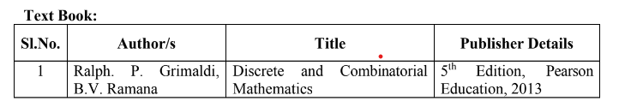
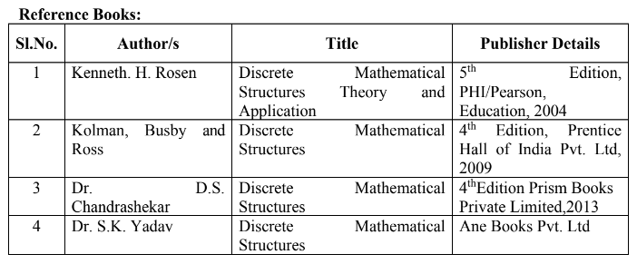

Slide 4

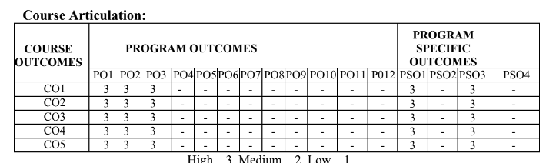

Slide 5
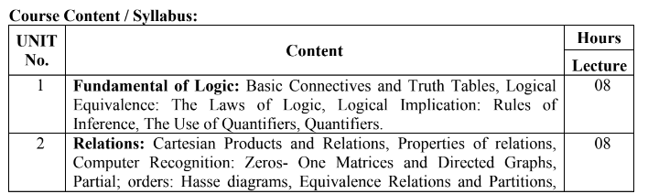
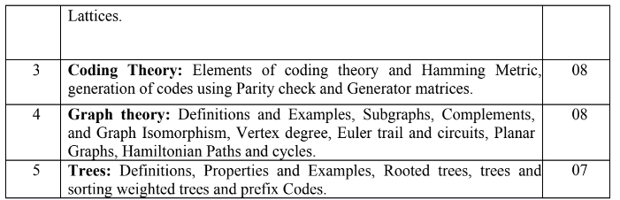

Slide 6
Unit 1
Fundamental of Logic

Slide 7
Unit 1
Fundamental of Logic: Basic Connectives and Truth Tables, Logical Equivalence: The Laws of Logic, Logical Implication: Rules of Inference, The Use of Quantifiers, Quantifiers.

Slide 8
Basic Connectives and Truth table
Proposition:
  A proposition is a declarative sentence that is either true or false, but not both.
Example:
  2 is a prime number. (true)
  All sides are equal in scalene triangle. (false)
  2+3=4. (false)
  What is the time now?
  Read this carefully.
  From the above examples we note that 1, 2, 3 are proposition, whereas 4 and 5 are not the propositions.

Slide 9
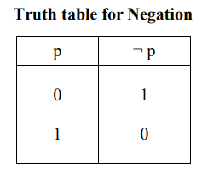
Logical Connectives and Truth table
New propositions are obtained by starting with given propositions with the aid of words or phrases like ‘not’, ‘and’, ‘if … then, and ‘if and only if’. Such words or phrases are called Logical connectives.
Negation:
  A proposition is obtained by inserting the word ‘not’ at an appropriate place in the given proposition is called the negation of the given proposition.
  The negation of a Proposition p is denoted by ¬ p (read ‘not p’).
  For any Proposition p, if p is true, then ¬ p is false, and if p is false, then ¬ p is true. i.e., If the truth value of a proposition p is 1 then the truth value of ¬ p is 0 and If the truth value of a proposition p is 0 then the truth value of ¬ p is 1. Example: p: 4 is an even number. ¬ p: 4 is not an even number.

Slide 10
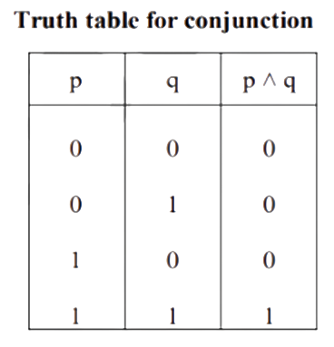
Conjunction:
  A compound proposition obtained by combining two given propositions by inserting the word ‘and’ in between them is called the conjunction of the given proposition.
  The conjunction of two propositions p and q is denoted by p ˄ q (read ‘p and q’).
  The conjunction p ˄ q is true only when p is true and q is true, in all other cases it is false. i.e., the truth value of the conjunction p ˄ q is 1 only when the truth value of p is 1 and truth value of q is 1, in all other cases the truth value of p ˄ q is 0.
  Example: p: √2 is an irrational number. q: 9 is a prime number. p ˄ q: √2 is an irrational number and 9 is a prime number.

Slide 11
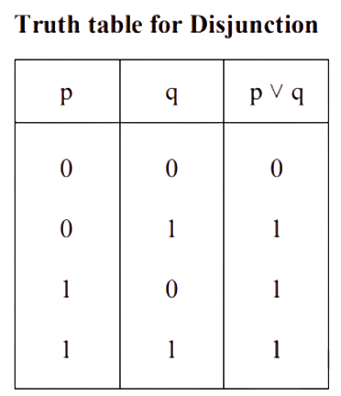
Disjunction:
  A compound proposition obtained by combining two given propositions by inserting the word ‘or’ in between them is called the disjunction of the given propositions.
  The disjunction of two propositions p and q is denoted by p ˅ q (read ‘p or q’).
  The disjunction p ˅ q is false only when p is false and q is false, in all other cases it is true. i.e., the truth value of the disjunction p ˅ q is 0 only when the truth value of p is 0 and truth value of q is 0, in all other cases the truth value of p ˅ q is 1.
  Example: p: All triangles are equilateral. q: 2+5=7. p ˅ q: All triangles are equilateral or 2+5=7.

Slide 12
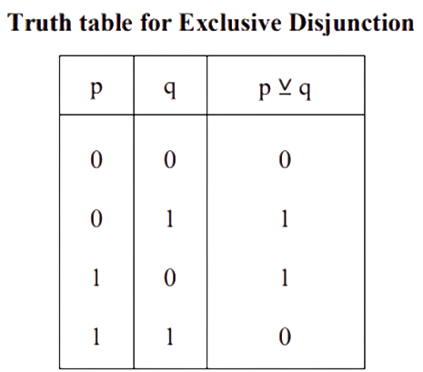
Exclusive Disjunction:
  We require that the compound proposition “p or q” to be true only when either p is true or q is true but not both.
  The exclusive or is denoted by the ⊻.
  The compound proposition p ⊻ q (read as either p or q but not both) is called as exclusive disjunction of the propositions p and q. i.e., p ⊻ q = (p ˄ ¬ q) ⅴ (q ˄ ¬ p)
  Example:
    p:9 is a prime number
    q: all triangles are isosceles. p ⊻ q:
    Either 9 is prime number or all triangles are isosceles, but not both

Slide 13
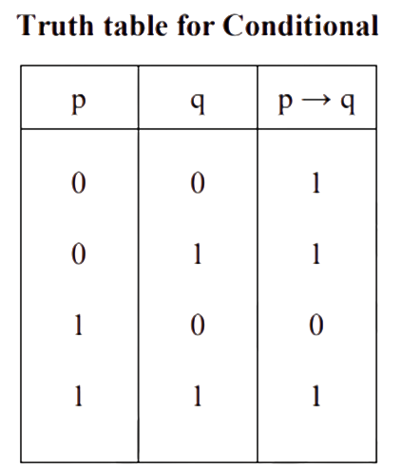
Conditional:
  A compound proposition obtained by combining two given propositions by using the words ‘if’ and ‘then’ at appropriate places is called a conditional.
  The Conditional “If p, then q” is denoted by p → q and the Conditional “If q, then p” is denoted by q → p.
  The Conditional p → q is false only when p is true and q is false, in all other cases it is true. i.e., the truth value of the conditional p → q is 0 only when the truth value of p is 1 and the truth value of q is 0, in all other cases the truth value of p → q is 1.
  Example:
    p: 3 is a prime number.
    q: 9 is a multiple of 6 d a conditional.

Slide 14
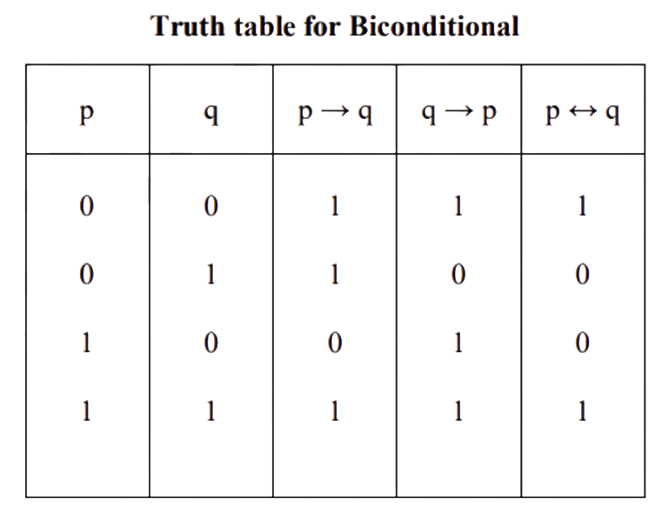
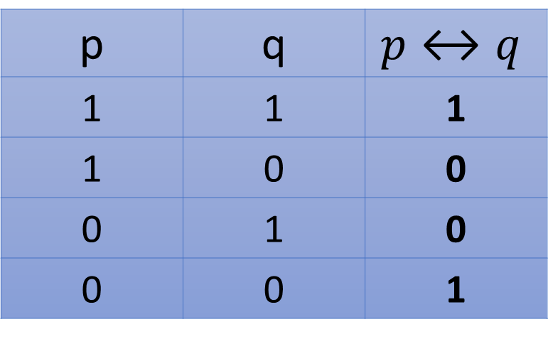
Biconditional:
  Let p and q be two sample propositions then the conjunction of the conditionals p → q and q → p is called the biconditional of p and q.
  It is denoted by p ↔ q and it is same as (p → q) ˄ (q → p) is read as “If p then q and if q then p”.
p | q | $$p↔q$$
1 | 1 | 1
1 | 0 | 0
0 | 1 | 0
0 | 0 | 1

Slide 15
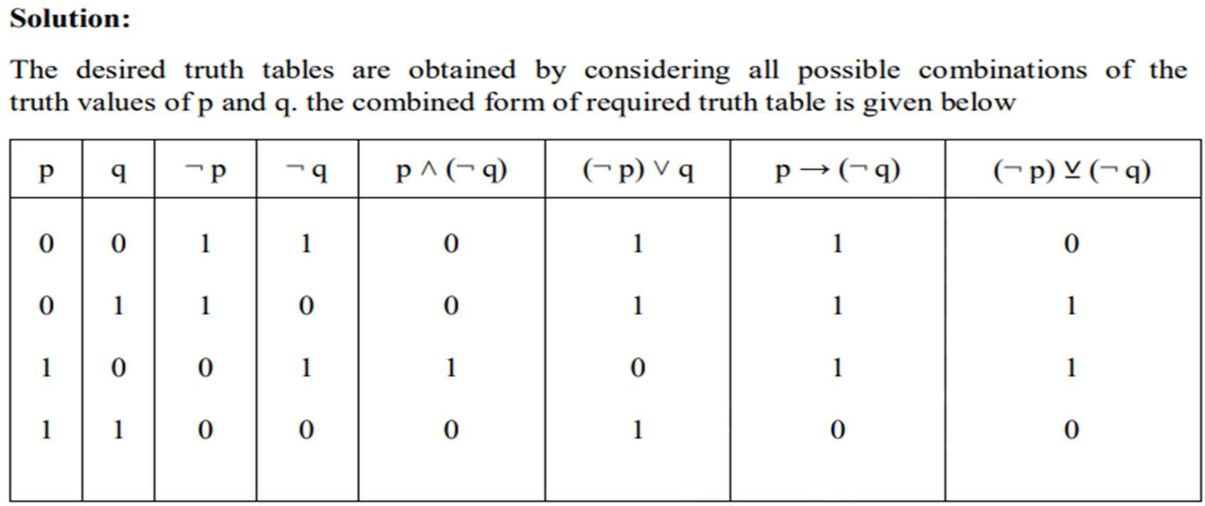
Problems: 1. Construct the truth tables for the following propositions.
(i) p ˄ (¬ q) (ⅱ) (¬ p) ˅ q
(ⅲ) p → (¬ q) (ⅳ) (¬ p) ⊻ (¬ q)

Slide 16
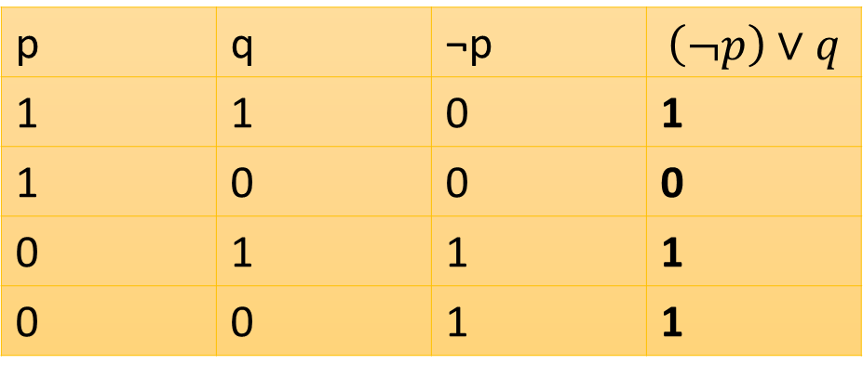
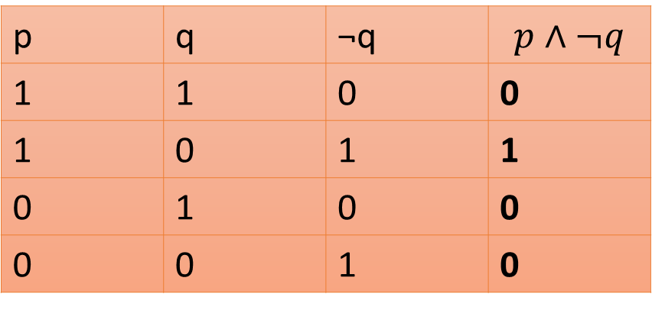
Problems: 1. Construct the truth tables for the following propositions.
(i) p ˄ (¬ q) (ⅱ) (¬ p) ˅ q
(ⅲ) p → (¬ q) (ⅳ) (¬ p) ⊻ (¬ q)
(i) p ˄ (¬ q)
(ⅱ) (¬ p) ˅ q
p | q | ¬q | $$p∧¬q$$
1 | 1 | 0 | 0
1 | 0 | 1 | 1
0 | 1 | 0 | 0
0 | 0 | 1 | 0
p | q | ¬p | $$\left(¬p\right)∨q$$
1 | 1 | 0 | 1
1 | 0 | 0 | 0
0 | 1 | 1 | 1
0 | 0 | 1 | 1

Slide 17
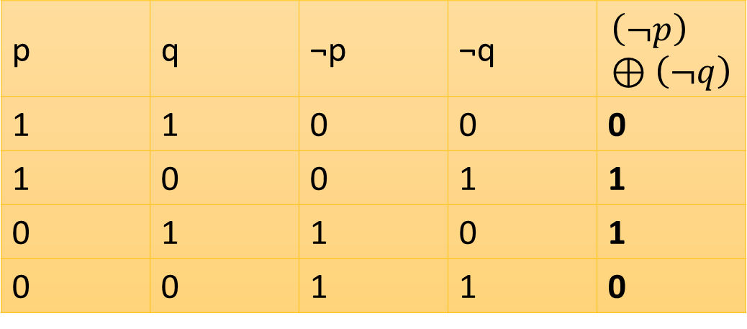
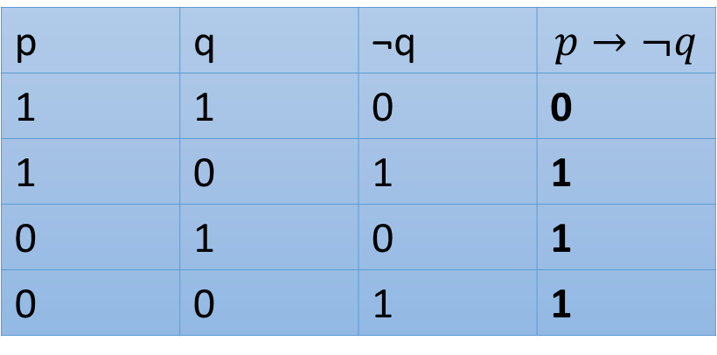
Problems: 1. Construct the truth tables for the following propositions.
(i) p ˄ (¬ q) (ⅱ) (¬ p) ˅ q
(ⅲ) p → (¬ q) (ⅳ) (¬ p) ⊻ (¬ q)
(ⅲ) p → (¬ q)
(ⅳ) (¬ p) ⊻ (¬ q)
p | q | ¬p | ¬q | $$\left(¬p\right)⊕\left(¬q\right)$$
1 | 1 | 0 | 0 | 0
1 | 0 | 0 | 1 | 1
0 | 1 | 1 | 0 | 1
0 | 0 | 1 | 1 | 0
p | q | ¬q | $$p→¬q$$
1 | 1 | 0 | 0
1 | 0 | 1 | 1
0 | 1 | 0 | 1
0 | 0 | 1 | 1

Slide 18
Problem 2: Let p, q and r be propositions having truth values 0, 0 and 1 respectively. Find the truth values if the following compound propositions:
(ⅰ) (p ˅ q) ˅ r (ⅱ) (p ˄ q) ˄ r (ⅲ)(p ˄ q) → r
(ⅳ) p → (q ˄ r) (ⅴ) p ˄ (q → r) (ⅵ) p → (q →¬ r)
Solution:
(ⅰ) Since both p and q are false then (p ˅ q) is also false. Since r true it follows that (p ˅ q) ˅ r is true. Thus, the truth value of (p ˅ q) ˅ r is 1.
(ⅱ) Since both p and q are false, (p ˄ q) is false. Since (p ˄ q) is false and r is true (p ˄ q) ˄ r is false. Thus, the truth value of (p ˄ q) ˄ r is 0.
(ⅲ) Since (p ˄ q) is false and r is true, (p ˄ q) → r is true. Thus, the truth value of (p ˄ q) → r is 1.
(ⅳ) Since q is false and r is true, (q ˄ r) is false. Also, p is false, therefore p → (q ˄ r) is true. Thus, the truth value of p → (q ˄ r) is 1.
(ⅴ) Since r is true and q is false (q → r) is true. Also, p is false. Therefore, p ˄ (q → r) is false. Thus, the truth value of p ˄ (q → r) is 0 (ⅵ) Since r is true, ¬ r is false. Since q is false, q → (¬ r) is true.

Slide 19
Problems 3: Indicate how many rows are needed in the truth table for the compound proposition (p ˅ (¬ q)) ↔ ((¬ r) ˄ s) → t. Find the truth value of the proposition if p and r, are true and q, s, t, are false.
Solution: The given compound proposition contains five primitives p, q, r, s, t. Therefore, the number of possible combinations of the truth values of these components which we have to consider is 2^5=32.
Hence 32 rows are needed in the truth table for the given compound proposition. Next, suppose that p and r, are true and q, s, t are false, then ¬ q is true and ¬ r is false.
Since p is true and ¬ q is true, (p ˅ (¬ q)) is true on the other hand, since ¬ r is false and s is false, ¬ r ˄ s is false.
Also, t is false. Hence ((¬ r) ˄ s) →t is true.
Since (p ˅ (¬ q)) is true and ((¬ r) ˄ s) → t is true, it follows that the truth values of the given propositions (p ˅ (¬ q)) ↔ ((¬ r ˄ s) → t is 1.

Slide 20
Problems 4: Let
p: A circle is a conic
q: √5 is a real number
r: Exponential series is convergent.
Express the following compound Proposition in words:
(i) p ˄ (¬ q) (ii) (¬ p) ˄ q (iii) q → (¬ p)
(iv) p ⊻ (¬ q) (v) p → (q ⊻ r) (vi) ¬ p ↔ q
Solution:
A circle is a conic and √5 is not a real number.
A circle is not a conic and √5 is a real number.
If √5 is a real number, then a circle is not a conic.
Either a circle is a conic or √5 is not a real number (but not both).
If a circle is a conic then either √5 is a real number or the exponential series is convergent (but not both).
If a circle is not a conic then √5 is a real number and if √5 is a real number then a circle is not a conic.

Slide 21
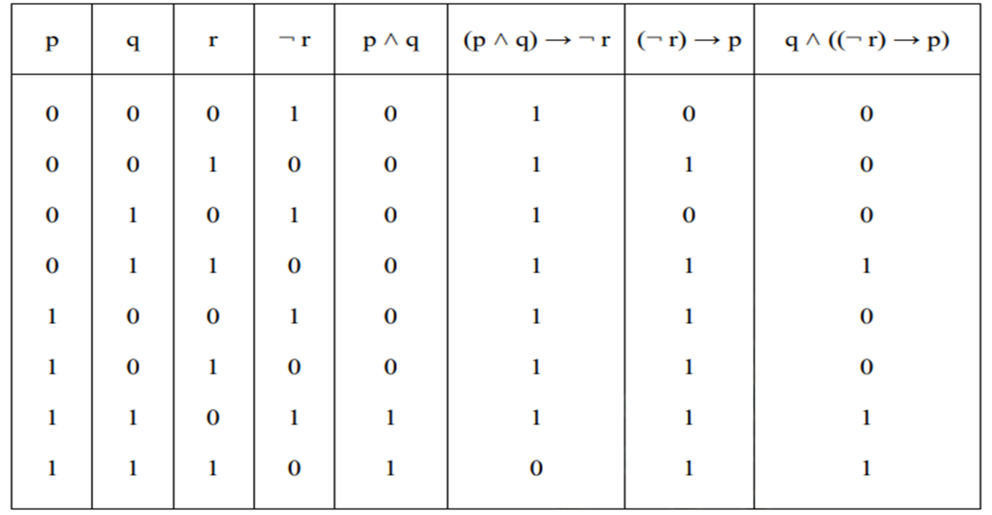
Problems 5: Construct the truth table for the following compound propositions:
(ⅰ) (p ˄ q) → ¬ r (ⅱ) q ˄ ((¬ r) → p)

Slide 22
Conditional
“if p, then q” “p implies q”
“if p, q” “p only if q”
“p is sufficient for q” “a sufficient condition for q is p”
“q if p” “q whenever p”
“q when p” “q is necessary for p”
“a necessary condition for p is q” “q follows from p”
“q unless ¬p”

Slide 23
Biconditional
“p is necessary and sufficient for q”
“if p then q, and conversely”
“p iff q.”

Slide 24
Let p be the statement “Maria learns discrete mathematics” and q the statement “Maria will find a good job.” Express the statement p → q as a statement in English.
Solution: From the definition of conditional statements, we see that when p is the statement
“Maria learns discrete mathematics” and q is the statement “Maria will find a good job,” p → q represents the statement
“If Maria learns discrete mathematics, then she will find a good job.”
There are many other ways to express this conditional statement in English. Among the most natural of these are:
“Maria will find a good job when she learns discrete mathematics.”
“For Maria to get a good job, it is sufficient for her to learn discrete mathematics.”
and
“Maria will find a good job unless she does not learn discrete mathematics.”

Slide 25
Tautology and Contradiction
A compound proposition which is true for all possible truth values of its components is called a tautology.
A compound proposition which is false for all possible truth values of its components is called Contradiction or an absurdity.
A compound proposition that can be true or false is called a contingency. In other words, a contingency is a compound proposition which is neither a tautology nor a contradiction.

Slide 26
Problems: 1 Show that for any proposition p and q, the compound proposition p → (p ˅ q) is a tautology and the compound proposition p ˄ (¬ p ˄ q) is called contradiction
Solution: Let us first prepare the truth tables for p → (p ˅ q) and p ˄ (¬ p ˄ q). these truth tables are shown below in the combined form.
p | q | p ˅ q | p → (p ˅ q) | ¬ p | (¬ p ˄ q) | p ˄ (¬ p ˄ q)
0 | 0 | 0 | 1 | 1 | 0 | 0
0 | 1 | 1 | 1 | 1 | 1 | 0
1 | 0 | 1 | 1 | 0 | 0 | 0
1 | 1 | 1 | 1 | 0 | 0 | 0
From the above table we note that, for all possible values of p and q the compound proposition p → (p ˅ q) is true and the compound proposition p ˄ (¬ p ˄ q) is false. Therefore p ˄ (¬ p ˄ q) is contradiction and p → (p ˅ q) is tautology.

Slide 27
2. Prove that, for any proposition p, q, r the compound proposition
(p → q) ˄ (q → r) → (p → r) is a tautology
Solution: The following truth table gives the required result.
p | q | r | p → q | q → r | (p → q) ˄ (q → r) | p → r | (p → q) ˄ (q → r) → (p → r)
0 | 0 | 0 | 1 | 1 | 1 | 1 | 1
0 | 0 | 1 | 1 | 1 | 1 | 1 | 1
0 | 1 | 0 | 1 | 0 | 0 | 1 | 1
0 | 1 | 1 | 1 | 1 | 1 | 1 | 1
1 | 0 | 0 | 0 | 1 | 0 | 0 | 1
1 | 0 | 1 | 0 | 1 | 0 | 1 | 1
1 | 1 | 0 | 0 | 0 | 0 | 0 | 1
1 | 1 | 1 | 0 | 1 | 1 | 1 | 1

Slide 28
Prove that for any proposition p, q, r the compound proposition
(p ˅ q) ˅ (p → r) ˄ (q → r) is tautology
Solution: The following truth table gives the required result
p | q | r | p → r | q → r | (p → r) ˄ (q → r) | p ˅ q | (p ˅ q) ˅ (p → r) ˄ (q → r)
0 | 0 | 0 | 1 | 1 | 1 | 0 | 1
0 | 0 | 1 | 1 | 1 | 1 | 0 | 1
0 | 1 | 0 | 1 | 0 | 0 | 1 | 1
0 | 1 | 1 | 1 | 1 | 1 | 1 | 1
1 | 0 | 0 | 0 | 1 | 0 | 1 | 1
1 | 0 | 1 | 1 | 1 | 1 | 1 | 1
1 | 1 | 0 | 0 | 0 | 0 | 1 | 1
1 | 1 | 1 | 1 | 1 | 1 | 1 | 1

Slide 29
Converse, Inverse and Contrapositive
Statement | If p , then q .
Converse | If q , then p .
Inverse | If not p , then not q .
Contrapositive | If not q , then not p .

Slide 30
Converse, Inverse and Contrapositive
Given an if-then statement "if p , then q ," we can create three related statements:
A conditional statement consists of two parts, a hypothesis in the “if” clause and a conclusion in the “then” clause.
For instance, “If it rains, then they cancel school.”
"It rains" is the hypothesis.
"They cancel school" is the conclusion.
To form the converse of the conditional statement, interchange the hypothesis and the conclusion.
The converse of "If it rains, then they cancel school" is "If they cancel school, then it rains."
To form the inverse of the conditional statement, take the negation of both the hypothesis and the conclusion.
The inverse of “If it rains, then they cancel school” is “If it does not rain, then they do not cancel school.”
To form the contrapositive of the conditional statement, interchange the hypothesis and the conclusion of the inverse statement.
The contrapositive of "If it rains, then they cancel school" is "If they do not cancel school, then it does not rain."

Slide 31
What are the contrapositive, the converse, and the inverse of the conditional statement “The home team wins whenever it is raining?”
Solution: Because “q whenever p” is one of the ways to express the conditional statement
p → q, the original statement can be rewritten as
“If it is raining, then the home team wins.”
Consequently, the contrapositive of this conditional statement is
“If the home team does not win, then it is not raining.”
The converse is
“If the home team wins, then it is raining.”
The inverse is
“If it is not raining, then the home team does not win.”
Only the contrapositive is equivalent to the original statement.

Slide 32
Converse, Inverse and Contrapositive
Example 1: If two angles are congruent, then they have the same measure.
Statement | If two angles are congruent, then they have the same measure.
Converse | If two angles have the same measure, then they are congruent.
Inverse | If two angles are not congruent, then they do not have the same measure.
Contrapositive | If two angles do not have the same measure, then they are not congruent.

Slide 33
Converse, Inverse and Contrapositive
Example 2: If a quadrilateral is a rectangle, then it has two pairs of parallel sides.
Statement | If a quadrilateral is a rectangle, then it has two pairs of parallel sides.
Converse | If a quadrilateral has two pairs of parallel sides, then it is a rectangle. (FALSE!)
Inverse | If a quadrilateral is not a rectangle, then it does not have two pairs of parallel sides. (FALSE!)
Contrapositive | If a quadrilateral does not have two pairs of parallel sides, then it is not a rectangle.

Slide 34
Assignment
Prove that for any proposition p, q, r the compound proposition [(p → q) ˄ (p → r)] → (p → r)) is tautology.
Prove that for any proposition p, q, r the compound proposition {p → (q → r)} → {(p → q) → (p → r)} is tautology.
Prove that for any proposition p, q, r the compound proposition (p → q) ˅ (p → r) ↔ (p → (q ˅ r)) is tautology.
Prove that for any proposition p, q, r the compound proposition [(p ˅ q) ˄ {(p → r) ˄ (q → r)}] → r is tautology.
Verify the Compound Proposition (p ˅ q) → r ↔ (¬ r → ¬ (p ˅ q)) is tautology or not.

Slide 35
Logic equivalence
Two statement s1, s2 are said to be logically equivalent, and we write s1↔s2, when the statement s1 is true (respectively false) if and only if the statement s2 is true (respectively false). Or the biconditional s1↔s2 is a tautology

Slide 36
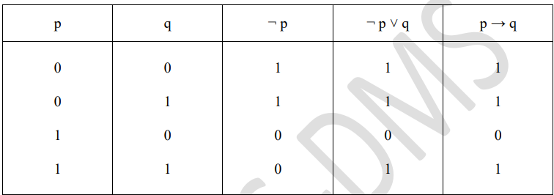
For any two propositions p, q Prove that (p → q)⇔( ¬ p) ˅ q
Solution: The following truth table gives the required result

Slide 37
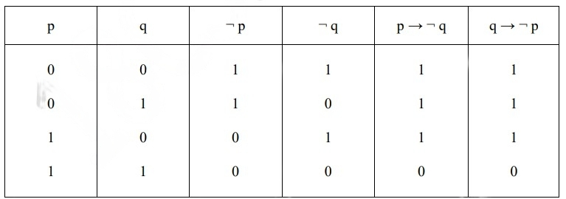
For any two propositions p, q Prove that (p →¬ q)⇔ (q → ¬ p)

Slide 38
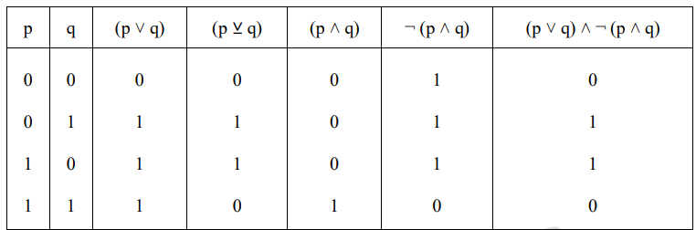
For any two propositions p, q Prove that (p ⊻ q)⇔(p ˅ q) ˄ ¬ (p ˄ q).

Slide 39
Assignment
For any propositions p, q, r. Prove that [(p → (q → r)]⇔ [(p ˄¬ r) → ¬ q)]
Show that the compound propositions p ˄ ((¬ q) ˅ r) and p ˅ (q ˄ (¬ r)) are not logically equivalent.

Slide 40
Equivalence | Name
p ∧ T ≡ p p ∨ F ≡ p | Identity laws
p ∨ T ≡ T p ∧ F ≡ F | Domination laws
p ∨ p ≡ p p ∧ p ≡ p | Idempotent laws
¬(¬p) ≡ p | Double negation law
p ∨ q ≡ q ∨ p p ∧ q ≡ q ∧ p | Commutative laws
(p ∨ q) ∨ r ≡ p ∨ (q ∨ r) (p ∧ q) ∧ r ≡ p ∧ (q ∧ r) | Associative laws
p ∨ (q ∧ r) ≡ (p ∨ q) ∧ (p ∨ r) p ∧ (q ∨ r) ≡ (p ∧ q) ∨ (p ∧ r) | Distributive laws
¬(p ∧ q) ≡ ¬p ∨ ¬q ¬(p ∨ q) ≡ ¬p ∧ ¬q | De Morgan’s laws
p ∨ (p ∧ q) ≡ p p ∧ (p ∨ q) ≡ p | Absorption laws
p ∨ ¬p ≡ T p ∧ ¬p ≡ F | Negation laws or Inverse laws
Logical Equivalences Involving Conditional Statements.
p → q ≡ ¬p ∨ q p → q ≡ ¬q → ¬p p ∨ q ≡ ¬p → q p ∧ q ≡ ¬(p → ¬q) ¬(p → q) ≡ p ∧ ¬q (p → q) ∧ (p → r) ≡ p → (q ∧ r) (p → r) ∧ (q → r) ≡ (p ∨ q) → r (p → q) ∨ (p → r) ≡ p → (q ∨ r) (p → r) ∨ (q → r) ≡ (p ∧ q) → r
Logical Equivalences Involving Biconditional Statements.
p ↔ q ≡ (p → q) ∧ (q → p) p ↔ q ≡ ¬p ↔ ¬q p ↔ q ≡ (p ∧ q) ∨ (¬p ∧ ¬q) ¬(p ↔ q) ≡ p ↔ ¬q

Slide 41
Applications of Switching Networks
A Switch is a device which allows the current or not allow the current in a switch.
A Switching network is made up of wires and switches connecting two terminals, say A and B.

Slide 42
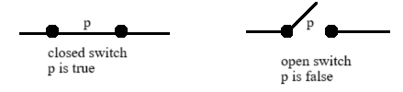
In such a network, each switch is open (so that no current flows through it) or closed ( so that current flows through it).
If a switch p is open, we assign the symbol is 0 to it and if p is closed we assign the symbol is 1 to it.

Slide 43

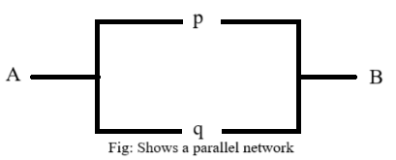
Current flows from the terminal A to the terminal B if the switch is closed, i.e.., if p is assigned the symbol 1. This network is represented by the symbol p.
Parallel Network consisting of two switches p and q in which the current flows from the terminal A to the terminal B if p or q or both are closed, that if p or q (or both) are assigned to 1. This network is represented by pvq

Slide 44

Series network consisting of two switches p and q in which the current flows from the terminal A to the terminal B if both p and q are closed, that is if both of p and q are assigned the symbol 1. This network by p^q.

Slide 45
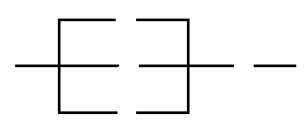
q
(q v p v ~q) ˄ r
A
p
r
B
~q
We find that
(q v p v ~q ) ˄ r {(q v ~q) v p} ˄ r using commutative law and associative law
(To v p) ˄ r, using inverse law
To ˄ r by domination law
r by identity law
This shows that the given network which has four switches is equivalent to a network that contains only one switch r. This simplified network is shown below.
A r B

Slide 46
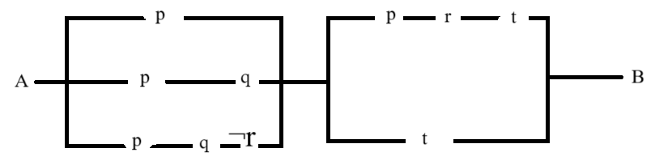

Slide 47
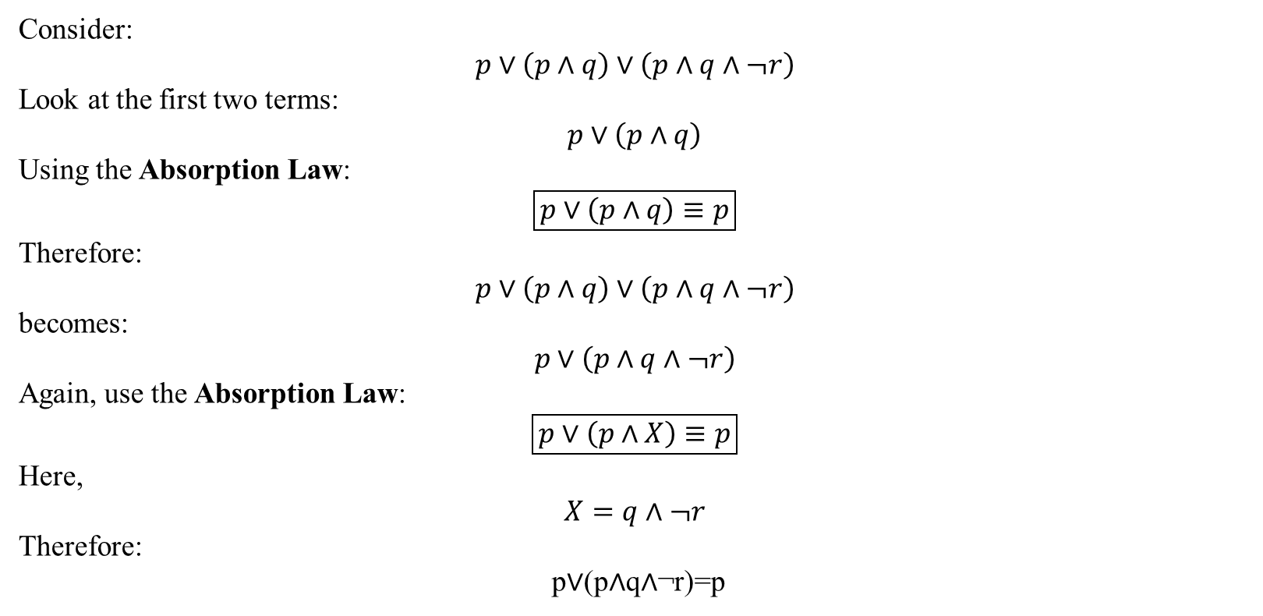
Consider:
$$p∨\left(p∧q\right)∨\left(p∧q∧¬r\right)$$
Look at the first two terms:
$$p∨\left(p∧q\right)$$
Using the Absorption Law:
$$\boxed{p∨\left(p∧q\right)≡p}$$
Therefore:
$$p∨\left(p∧q\right)∨\left(p∧q∧¬r\right)$$
becomes:
$$p∨\left(p∧q∧¬r\right)$$
Again, use the Absorption Law:
$$\boxed{p∨\left(p∧X\right)≡p}$$
Here,
$$X=q∧¬r$$
Therefore:
p∨(p∧q∧¬r)=p​

Slide 48
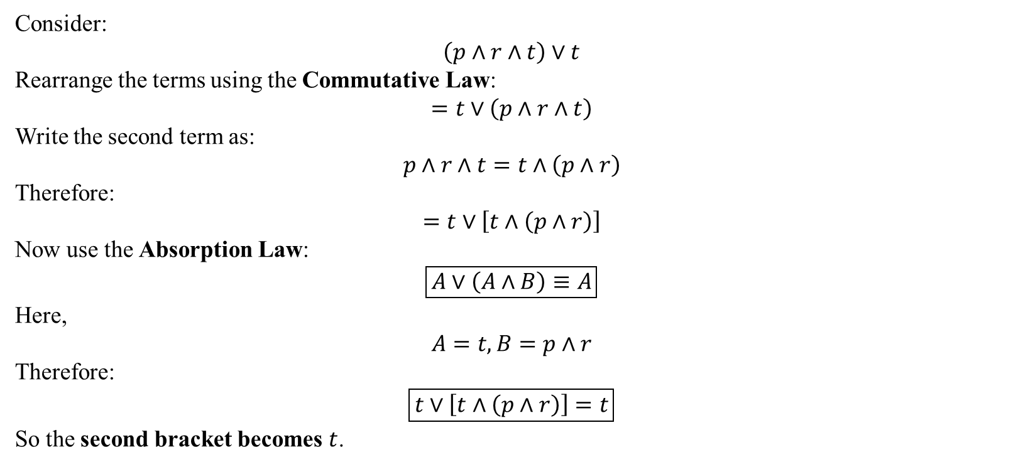
Consider:
$$\left(p∧r∧t\right)∨t$$
Rearrange the terms using the Commutative Law:
$$=t∨\left(p∧r∧t\right)$$
Write the second term as:
$$p∧r∧t=t∧\left(p∧r\right)$$
Therefore:
$$=t∨\left[t∧\left(p∧r\right)\right]$$
Now use the Absorption Law:
$$\boxed{A∨\left(A∧B\right)≡A}$$
Here,
$$A=t, B=p∧r$$
Therefore:
$$\boxed{t∨\left[t∧\left(p∧r\right)\right]=t}$$
So the second bracket becomes $t$.

Slide 49
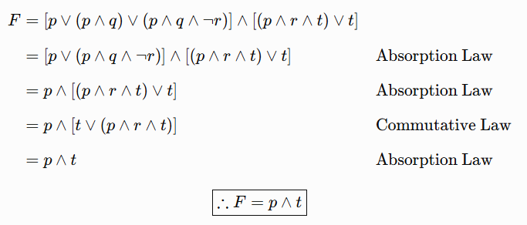

Slide 50
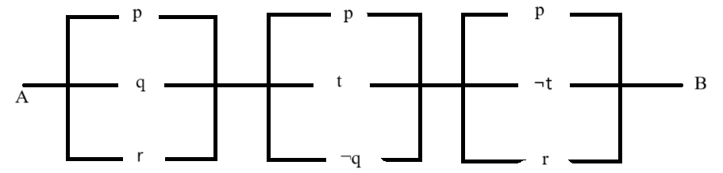
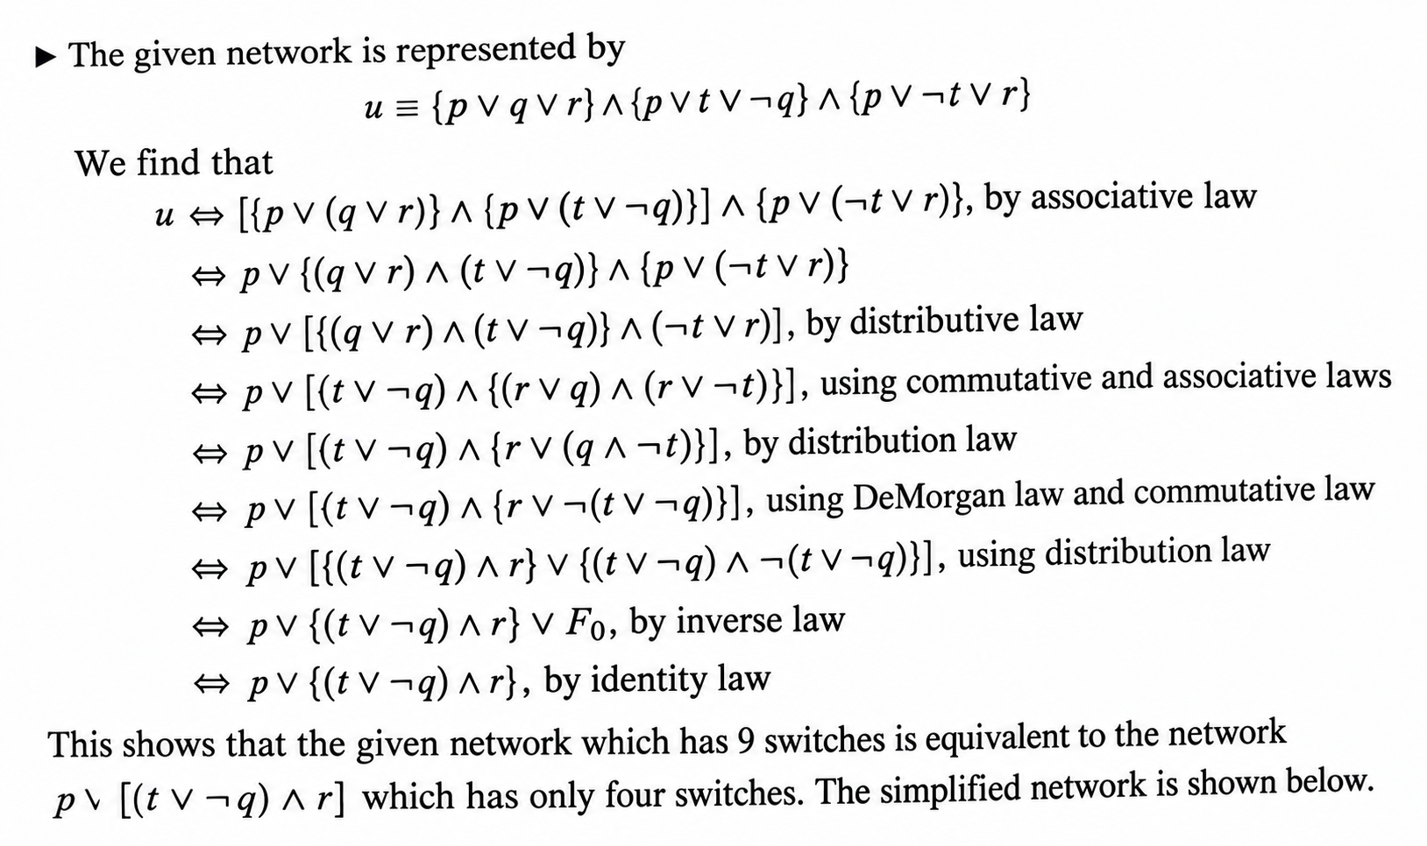

Slide 51
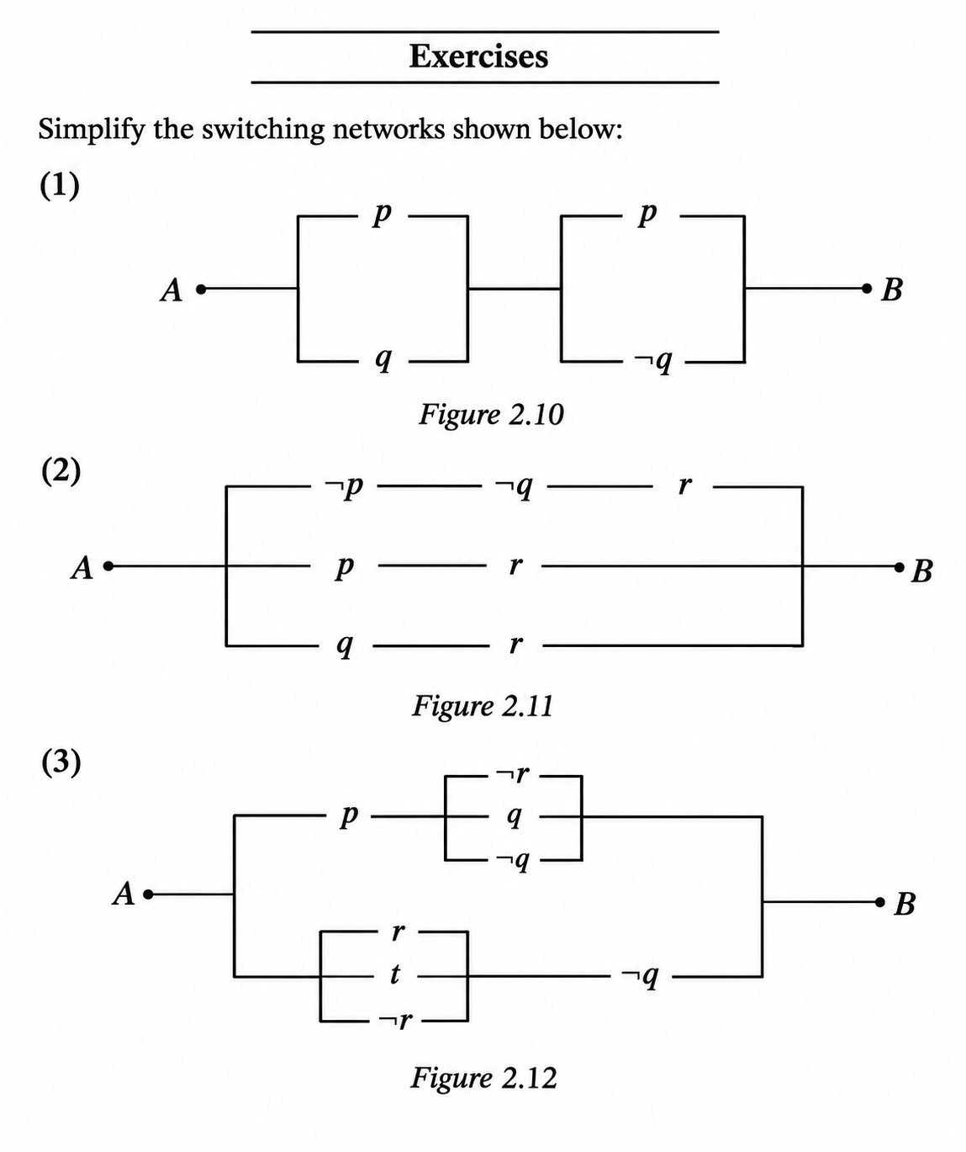
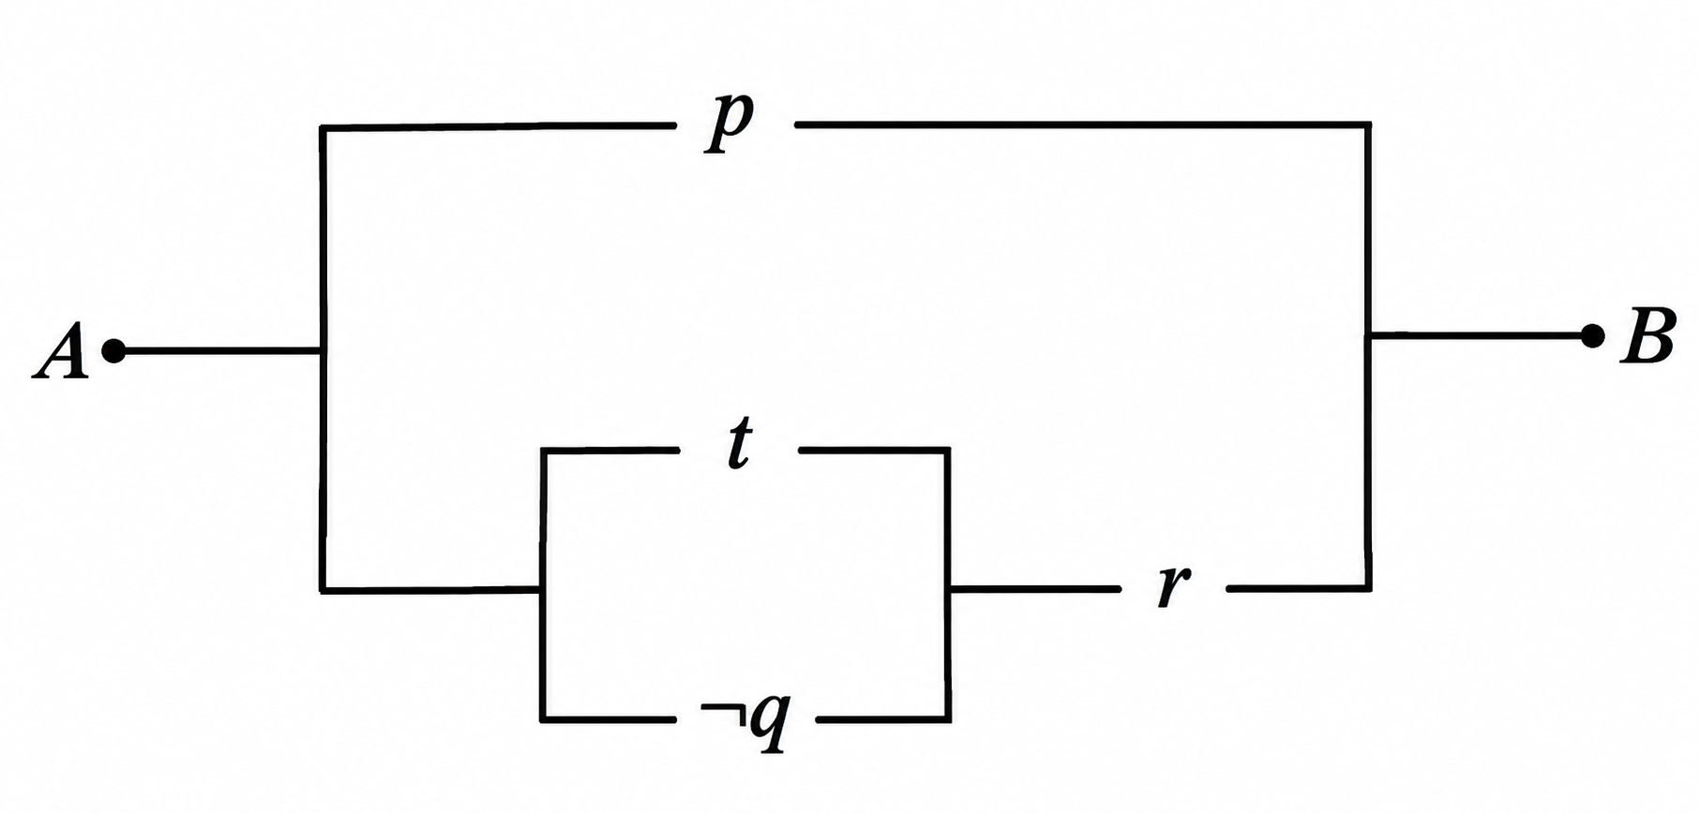
Assignment

Slide 52
Duality
Let s be a statement. If s contains no logical connectives other than ˄ and ⅴ, the dual of s denoted by s^{d} , is the statement obtained from s by replacing each occurrence of ˄ and ⅴ by ⅴ and ˄ respectively, and each occurrence of To and Fo by Fo and To, respectively.
Example: Given the primitive statements p, q, r and the compound statements
s: (p ˄ (¬ q)) ⅴ (r ˄ To)
s^d : (p ⅴ (¬ q)) ˄ (r ⅴ Fo)

Slide 53
Duality
The following two results are the importance
(u^{d})^{d} u
(b) For any two propositions u and v, if u v, then u^{d} v^{d} . (This is known as the Principle of Duality).

Slide 54
Duality
¬(p v q) ∧ [p v ¬(q ∧ ¬s)]
¬(p ∧ q) v [p ∧ ¬(q v ¬s)]
(p ∧ q) v [(¬p v q) ∧ (¬r v s)] v (r ∧ s)
(p v q) ∧ [(¬p ∧ q) v (¬r ∧ s)] ∧ (r v s)
[(p v To) ∧ (qvFo)] v [(r ∧ s) ∧ To]
[(p ∧ Fo) v (q ∧ To)] ∧ [(r v s) v Fo]

Slide 55
Duality
p→q
(p→q)→r
p→(q→r)
(p→q)→r
[(p→q)→r]^{d}
[¬(p→q)v r]^{d}
[¬ (¬pvq)v r]^{d}
[{¬ (¬p) ∧ (¬q)}v r]^{d}
(p v ¬q) ∧ r
  p→(q→r)
  [p→(q→r)]^{d}
  [¬ p v (q→r)]^{d}
  [¬ p v ¬ (q v r)]^{d}
  [¬ p ∧ ¬ (q ∧ r)]
(p→q)^{d}
(¬pvq)^{d}
(¬p ∧ q)

Slide 56
Duality
(p→q)^{d} Prove that [(¬p v q) ∧ (p ∧ (p ∧ q))]
p ∧ q
Applying duality
[(¬p ∧ q) v (p v (p v q))]
p v q
[(¬p v q) ∧ (p ∧ (p ∧ q))]
[(¬p v q) ∧ (p ∧ (p ∧ q))]
[(¬p v q) ∧ ((p ∧ p) ∧ q)]
[(¬p v q) ∧ (p ∧ q)]
[(¬p ∧ (p ∧ q)] v [(q ∧ (p ∧ q)]
[(Fo ∧ q)] v [(q ∧ q)∧ p]
Fo v [q ∧ p]
[q ∧ p]

Slide 57
Duality
Verify the principle of duality for the following logical equivalences
[(¬p ∧ q) → ¬p v (¬p v q))]
(¬p v q )

Slide 58
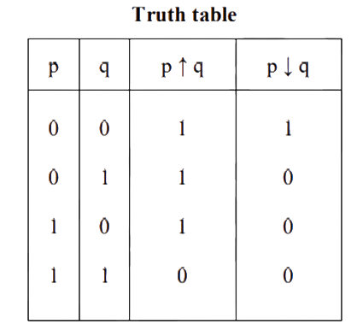
The Connectives NAND and NOR
The compound proposition ¬ (p ˄ q) is read as “Not p and q” and also denoted by (p ↑ q). The symbol ↑ is called NAND connective.
The compound proposition ¬ (p ⅴ q) is read as “Not p or q” and also denoted by (p ↓ q). The symbol ↓ is called the NOR connective

Slide 59
Problems: 1. For any propositions p, q Prove the following
(i). ¬ (p ↓ q) ⇔ ¬ p ↑ ¬ q (ii). ¬ (p ↑ q) ⇔ ¬ p ↓ ¬ q
Solution:
Using definition, we find that
¬ (p ↓ q) ⇔ ¬ [ ¬ (p ⅴ q)]
⇔ ¬ [ ¬ p ˄ ¬ q]
⇔ ¬ p ↑ ¬ q
ii. ¬ (p ↑ q) ⇔ ¬ [ ¬ (p ˄ q)]
⇔ ¬ [ ¬ p ⅴ ¬ q]
⇔ ¬ p ↓ ¬ q

Slide 60
2. For any propositions p, q, r Prove the following
(i). p ↑ (q ↑ r) ⇔ ¬ p ⅴ (q ˄ r) (ii). (p ↑ q) ↑ r ⇔ (p ˄ q) ⅴ ¬ r (iii). p ↓ (q ↓ r) ⇔ ¬ p ˄ (q ⅴ r) (iv). (p ↓ q) ↓ r ⇔ (p ⅴ q) ˄ ¬ r
Solution: Using definition, we find that
(i). p ↑ (q ↑ r) ⇔ ¬ [p ˄ (q ↑ r))]
⇔ ¬ [p ˄ ¬ (q ˄ r)]
⇔ ¬ p ⅴ ¬ [ ¬ (q ˄ r)]
⇔ ¬ p ⅴ (q ˄ r)
(ii). (p ↑ q) ↑ r ⇔ ¬ [(p ↑ q) ˄ r]
⇔ ¬ [¬ (p ˄ q) ˄ r]
⇔ ¬ [¬ (p ˄ q)] ⅴ ¬ r
⇔ (p ˄ q) ⅴ ¬ r

Slide 61
(iii). p ↓ (q ↓ r) ⇔ ¬ [p ⅴ (q ↓ r))]
⇔ ¬ [p ⅴ ¬ (q ⅴ r)]
⇔ ¬ p ˄ ¬ [ ¬ (q ⅴ r)]
⇔ ¬ p ˄ (q ⅴ r)
(iv). (p ↓ q) ↓ r ⇔ ¬ [(p ↓ q) ⅴ r]
⇔ ¬ [¬ (p ⅴ q) ⅴ r]
⇔ ¬ [¬ (p ⅴ q)] ˄ ¬ r
⇔ (p ⅴ q) ˄ ¬ r

Slide 62
Rules of inference
Let us consider the implication (p1 ˄ p2 ˄ …. ˄ pn) → q Here n is a positive integer, the statements p1,p2,…. pn are called the premises of the argument and q is called the conclusion of the argument.
We write the above argument in the following tabular form:
𝑝1
𝑝2
𝑝3
⋮
⋮
𝑝𝑛
∴ q

Slide 63
Rules of inference
The preceding argument is said to be valid if whenever each of the premises p1, p2, …. pn is true, then the conclusion q is likewise true. i.e., (p1 ˄ p2 ˄ …. ˄ pn) → q is valid when (p1 ˄ p2 ˄ …. ˄ pn) ⇒ q It is to be emphasized that in an argument, the premises are always taken to be true whereas the conclusion may be true or false.
The conclusion is true only in the case of valid argument.
There exist rules of logic which can be employed for establishing the validity of arguments. These rules are called Rules of Inference.

Slide 64
Rules of inference
(p1 ˄ p2 ˄ …. ˄ pn) → q
We write the above argument in the following tabular form:
𝑝1
𝑝2
𝑝3
⋮ Premises
⋮
𝑝𝑛
∴ q ------→ Conclusion

Slide 65
Basic Terminology
Premises: It is a proposition on the basis of which we would able to draw a conclusion. Premise as an evidence or assumption.
Initially we assume something is true and on the basis of that assumption, we will draw some conclusion.
Conclusion: It is proposition that is reached from the given set of premises. It is result of assumptions that we made in an argument.
If premises then conclusion
Argument: Sequence of statements that ends with a conclusion.
OR
It is a set of one or more premises and a conclusion.

Slide 66
Basic Terminology
Valid Argument: An argument is said to be valid if it is not possible to make all premises true and conclusion false.
Example of an argument:
“If I love cat then I love dog.”
“I love cat”
Therefore, “I love dog”
OR
Premises: “If I love cat then I love dog.”
“I love cat”
Conclusion: “I love dog”

Slide 67
Basic Terminology
“If I love cat then I love dog.”
“I love cat”
Therefore, “I love dog”
p → q
((p → q) ^ p) → q
p
OR
q
T
T
p → q
T
p
T
q
T
Valid Argument

Slide 68
Basic Terminology
“If I love cat then I love dog.”
“I love dog”
Therefore, “I love cat”
p → q
((p → q) ^ q) → p
q
OR
p
F
T
p → q
T
q
T
p
F
Invalid Argument

Slide 69
Rules of Inference
Rules of Inference: are the templated for constructing valid arguments.
Deriving conclusion from premises

Slide 70
Types of Inference Rules
T
p → q
T
Modus Ponens:
T
((p → q) ^ p) → q
p
T
OR
؞
q
T
Modus Tollens:
F
F
p → q
T
((p → q) ^ p) → ~p
OR
p
F
؞
~p
T

Slide 71
Types of Inference Rules
T
p → q
T
Hypothetical Syllogism:
T
((p → q) ^( q → r) → (p → r)
q → r
OR
؞
T
p → r
T
Disjunctive Syllogism:
F
T
p v q
T
((p v q) ^ ~ p) → q
OR
~p
T
؞
q
T

Slide 72
Types of Inference Rules
T
p
Addition:
T
p →(p v q)
؞
OR
p v q
T
Simplification:
T
T
p ^ q
p ^ q
((p ^ q) ^ ~ p) → q
T
؞
؞
OR
T
OR
p
q

Slide 73
Types of Inference Rules
T
p
Conjunction:
T
[(p) ^ (q)] → (p ^ q)
OR
q
T
؞
p ^ q
T
Resolution:
T
T
p v q
T
OR
[(p v q) ^ (~ p v r)] → (q v r)
~p v r
T
؞
q v r
T

Slide 74
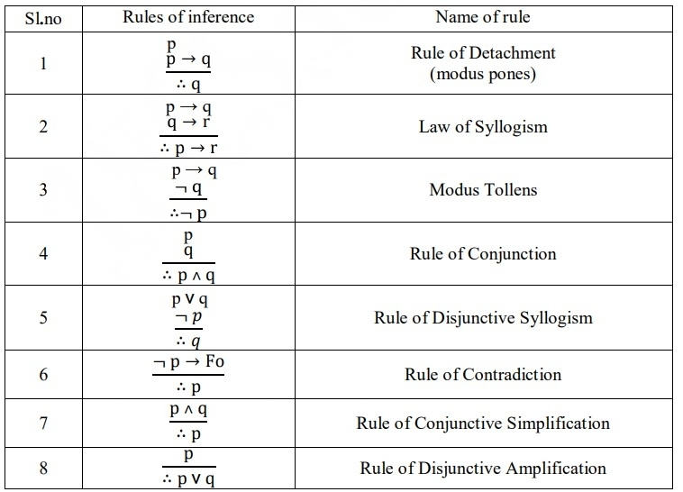

Slide 75
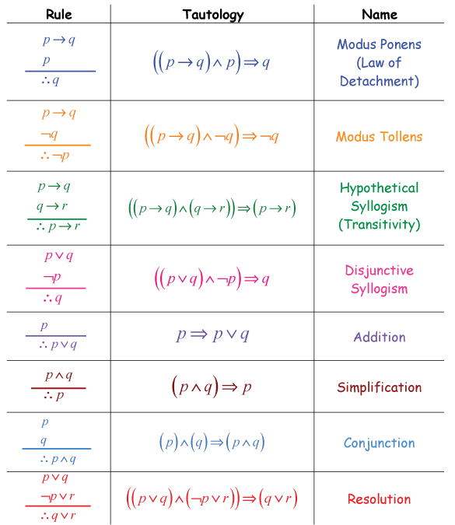

Slide 76
Rule | Name
Modus Ponens | ( ( p -> q ) ^ p) -> q
Modus Tollens | ( ( p -> q ) ^ ~q ) -> ~q
Hypothetical Syllogism | ( ( p -> q ) ^ (q -> r) ) -> (p -> r)
Disjunctive Syllogism | ( ( p v q ) ^ ~p ) -> q
Addition | p => p v q
Simplification | p ^ q => p
Conjunction | (p) ^ (q) => (p ^ q)
Resolution | (p v q) ^ (~p v r)) => ( q v r)
Truth Table Generator link: https://trutabgen.com/

Slide 77
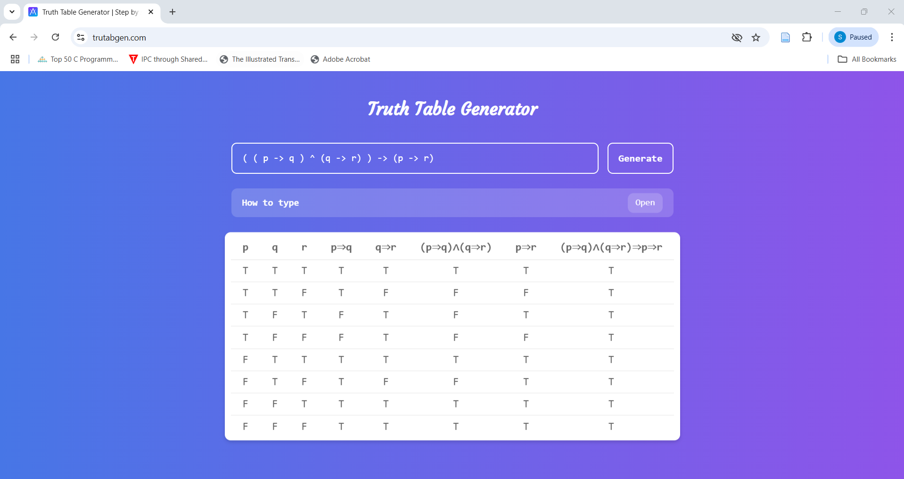

Slide 78
Rule of Inference | Description
Modus Ponens (MP) | If P implies Q, and P is true, then Q is true.
Modus Tollens (MT) | If P implies Q, and Q is false, then P is false.
Hypothetical Syllogism (HS) | If P implies Q and Q implies R, then P implies R.
Disjunctive Syllogism (DS) | If P or Q is true, and P is false, then Q is true.
Addition (Add) | If P is true, then P or Q is true.
Simplification (Simp) | If P and Q are true, then P is true
Conjunction (Conj) | If P and Q are true, then P and Q are true.

Slide 79
Problems: 1 Test whether the following is valid argument.
If Sachin hits a century, then he gets a free car.
Sachin hits a century.
∴ Sachin gets a free car.
Solution: Let
p: Sachin hits a century.
q: Sachin gets a free car.
The given statement reads
p → q 𝑝 ∴ q
In view of Modus Pones Rule, this is a valid argument.

Slide 80
Problem 2: Test the validity of the following arguments.
If Ravi goes out with friends, he will not study.
If Ravi does not study, his father will become angry.
His father is not angry.
∴ Ravi has not gone out with friends.
Solution: Let
p: Ravi goes out with friends. q: Ravi does not study.
r: His father gets angry.
Then the given argument reads.
p → q
q → r
¬ 𝑟
∴ ¬ 𝑝
This argument is logically equivalent to (Using the rule of syllogism)
𝑝 → 𝑟
¬ 𝑟
∴ ¬ 𝑝
In view of Modus Tollens Rule, this is a valid argument.

Slide 81
Test whether the following is valid argument.
If Sachin hits a century, then he gets a free car.
Sachin does not get a free car.
∴ Sachin has not hit a century
Solution: Let
p: Sachin hits a century.
q: Sachin gets a free car.
The given statement reads
p → q
¬ q
∴ ¬ 𝑝
In view of Modus Tollens Rule, this is a valid argument

Slide 82
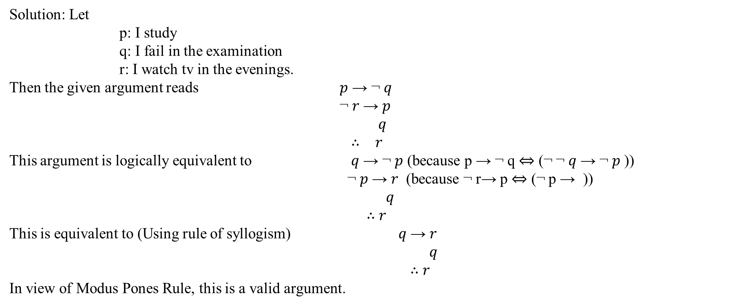
Test the validity of the following argument If I study, then I’ll not fail in the examination. If I do not watch tv in the evenings, I will study. I failed in the examination. ∴ I must have watched tv in the evenings.
Solution: Let
p: I study
q: I fail in the examination
r: I watch tv in the evenings.
Then the given argument reads 𝑝 → ¬ 𝑞
¬ 𝑟 → 𝑝 𝑞
∴ 𝑟
This argument is logically equivalent to 𝑞 → ¬ 𝑝 (because p → ¬ q $⇔$ (¬ ¬ 𝑞 → ¬ 𝑝 )) ¬ 𝑝 → 𝑟 (because ¬ r→ p $⇔$ (¬ p → )) 𝑞
∴ 𝑟
This is equivalent to (Using rule of syllogism) 𝑞 → 𝑟 𝑞 ∴ 𝑟
In view of Modus Pones Rule, this is a valid argument.

Slide 83
Test the validity of the following argument If I study, then I’ll not fail in the examination. If I do not watch tv in the evenings, I will study. I failed in the examination. ∴ I must have watched tv in the evenings.
Solution: Let
p: I study
q: I fail in the examination
r: I watch tv in the evenings.
Then the given argument reads 𝑝 → ¬ 𝑞
¬ 𝑟 → 𝑝 𝑞
∴ 𝑟
T
F
T→ F = F
F
𝑝 → ¬ 𝑞
¬ 𝑟 → 𝑝 𝑞
∴ 𝑟
T
T
T
F
T
T
T → T = T
T
T
T
T
F
F
Valid Argument

Slide 84


